Slide 1
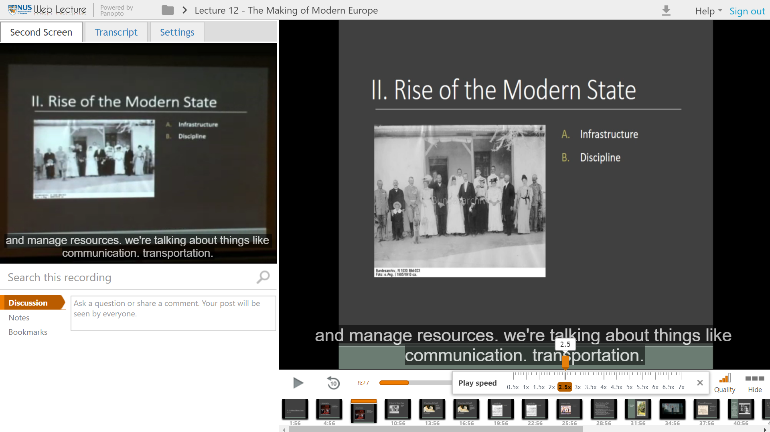
Panopto Plus (Features thus far)
Sidebar navbar to tab between screen, transcript and settings
Silence Trimming
(Automated removal of non speaking sections)
Subtitles
(synced on both video streams)
Subtitles
(synced on both video streams)
Playback speed slider
Stay tuned for more upcoming features:
Volume Booster
(Increase volume beyond maximum)
Retractable sidebar
Transcript (stand-alone sidebar & below screen)
Finished Settings tab
Customizable carousel
Responsiveness (still able to watch webcast with browser minimized)
Smaller Carousel
Milestone 2 Submission By Group 1 Matthew & Fyonn

